Slide 1
Nov. 2023
CS 313E Final Project
Scholar-Sorter
A way to find, filter and sort scholarships at your disposal
Halil and Tofik Hamscho
Elements of Computing Certificate, The University of Texas at Austin
Notes:
Halil

Slide 2



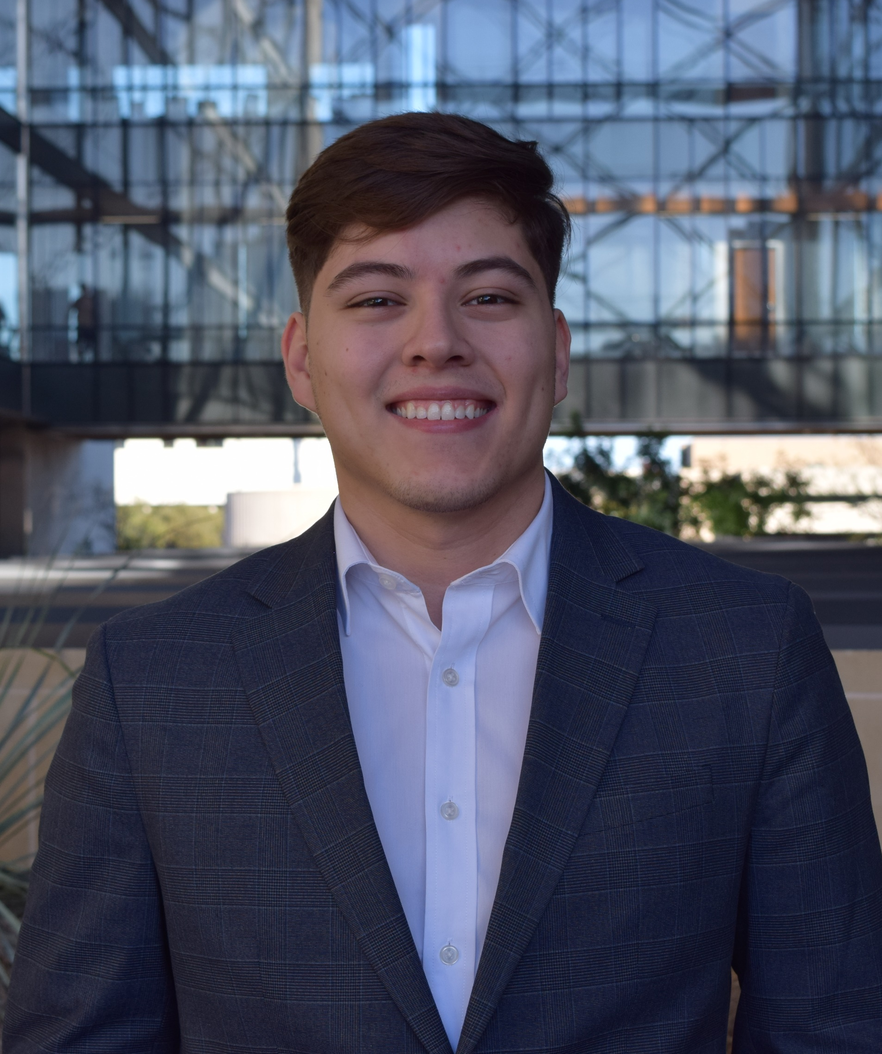
Meet the Team
Halil Hamscho
Junior
Mechanical Eng
Tofik Hamscho
Junior
Mechanical Eng
Notes:
Halil

Slide 3
Problem Statement
Challenge
Vast amounts of scholarship information with various deadlines
Daunting and time-consuming task, especially for students from underprivileged backgrounds
Impact
Stressful and decreased focus on studies
Educational inequality
Current Solutions
No optimized and comprehensive tools
Need
More efficient, user-friendly tool
Lack personalized filtering options
Tailored filtering, automate data gathering, and easily digestible format
Notes:
Halil
There is a extremely vast amount of scholarships throughout the internet
PARTICULAR
PERSONALIZED
Physically find these scholarships

Slide 4

Project Overview
Scholar-Sorter
A specialized tool designed to automate and simplify the process of finding scholarships.
Utilizes web scraping technology to gather and organize scholarship information from Scholarship America
Notes:
Halil
One of the BIGGEST SCHOLARSHIP WEBSITES

Slide 5

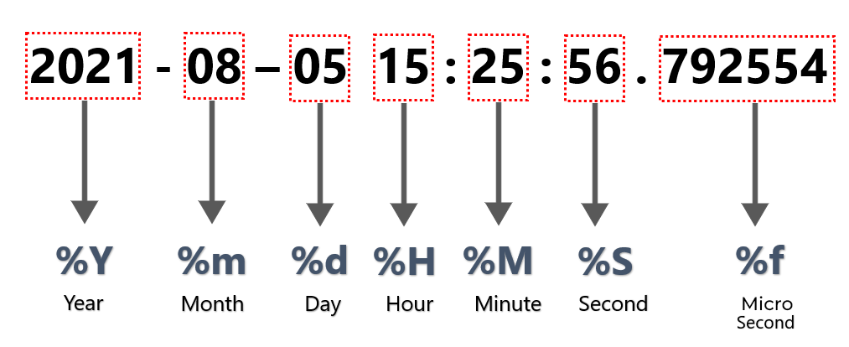
Libraries Utilized
Beautiful Soup
a Python package for parsing HTML and XML documents
Datetime
Python's built-in datetime library to manipulate date and time object data.
Notes:
Tofik
First we used Beautiful Soup, which is a library in Python commonly used for Web Scrapping. It has built in modules that obtain the necessary HTML data and requests from the desired URL
Next, we also used Datetime which is a library in Python that allowed us to manipulate the date data that we scrapped from the scholarship website. Essentially, it changes string dates to numerical values.

Slide 6
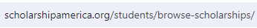
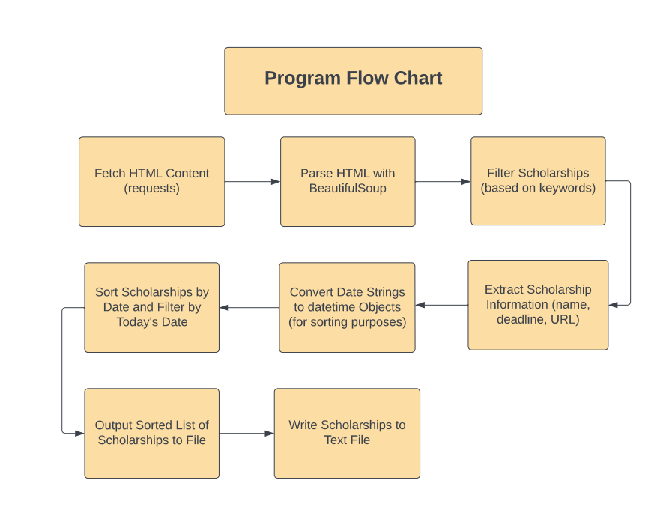
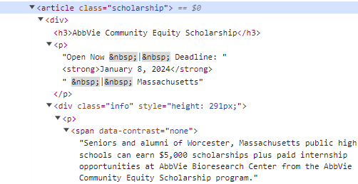
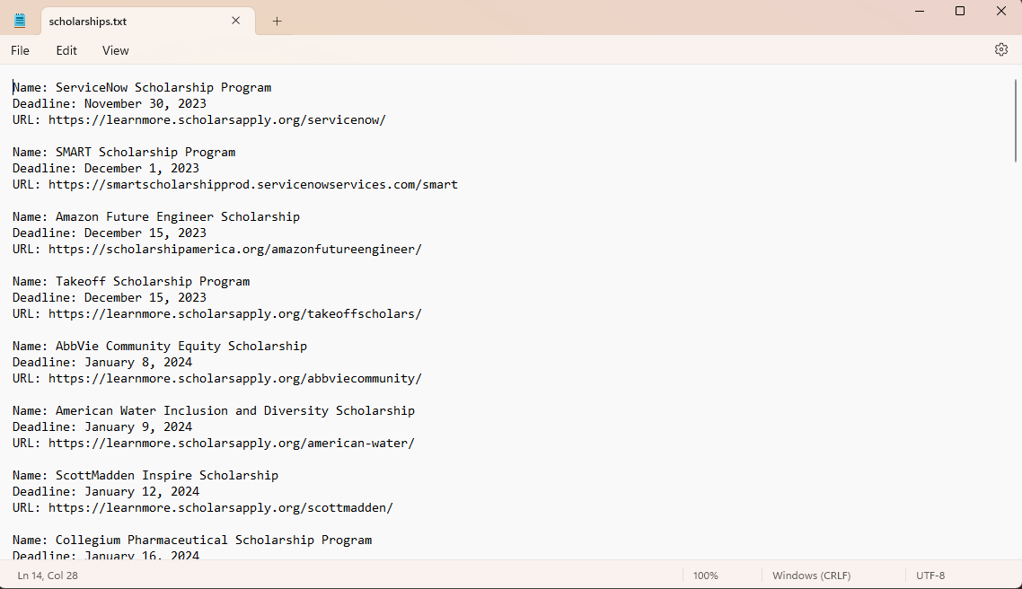
Steps:
1. URL
Implementation
2. Keywords to Filter
3. HTML Parsed and Extracted
4. Filtered and Sorted .txt File
Notes:
Tofik
Now we move on to the implementation.
This is where we explain how the processing of scholarship through out program happens.
First we obtain the necessary HTML content from the website with BeautifulSoup. In the website, each scholarship has a Name Deadline and Information
Next, we parse through the HTML content with BeautifulSoup to transforms the raw HTML content, which is just a string of characters, into a structured, navigable format that you can easily interact with our Python code.
Next, with the decoded HTML content, each scholarship has a section of Information which we can filter through. By selecting especial keywords to be present in the Information section of scholarships we filter through which scholarships we want
Next, if the scholarship has the selected keywords in its text we filter it and extract its information
Next, we want

Slide 7
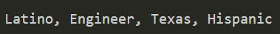
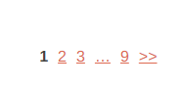
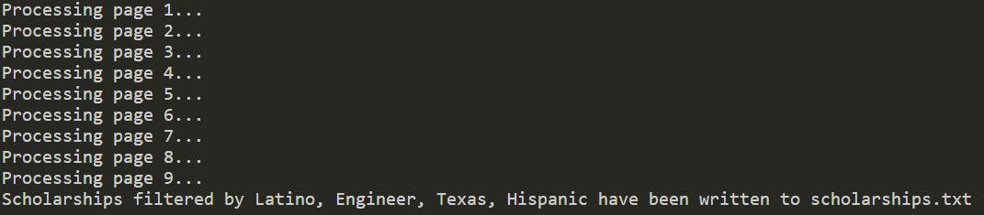
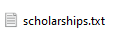
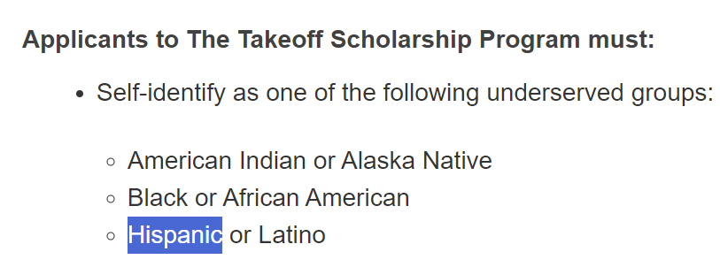
Test Case 1
Input
Processing
Output
Notes:
Halil

Slide 8
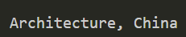
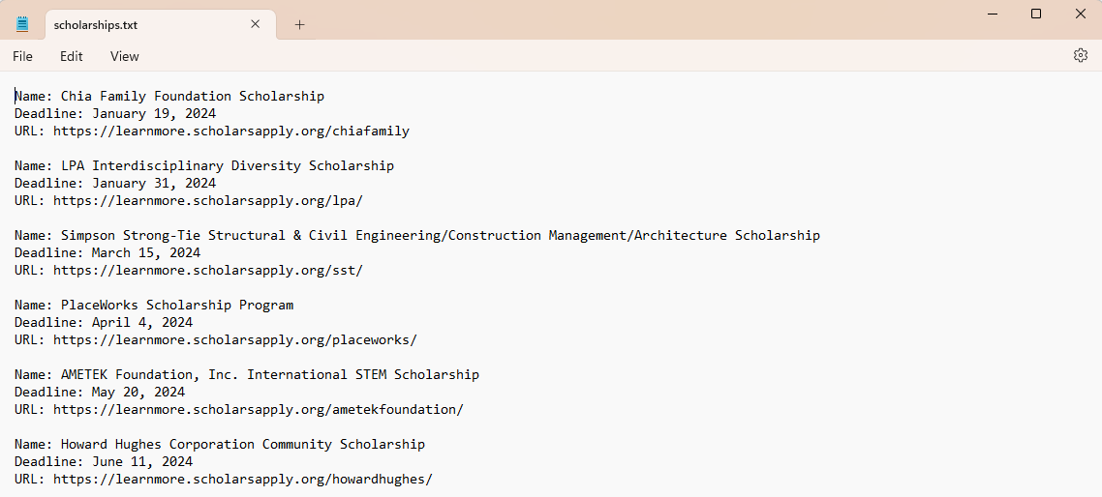
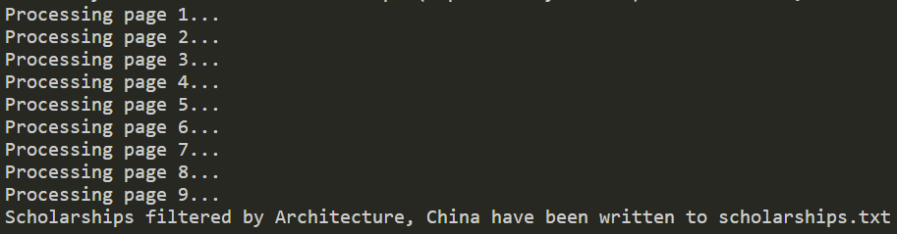
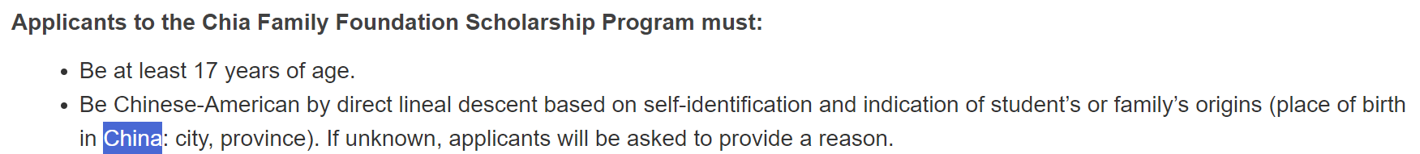
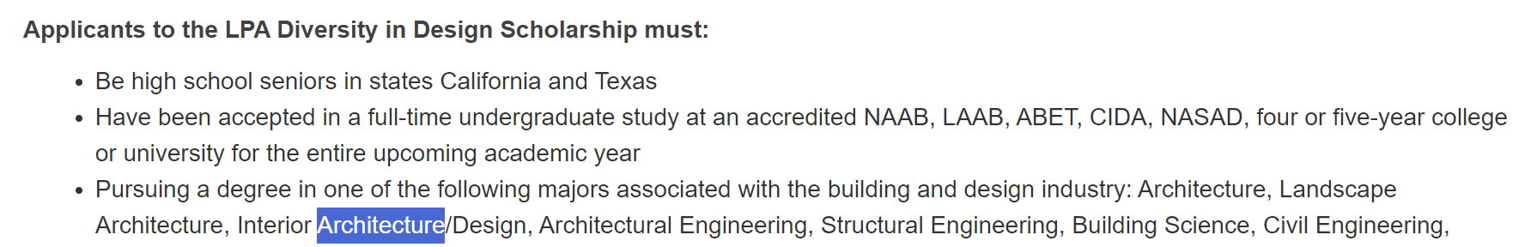
Test Case 2
Input
Processing
Output
Notes:
Halil

Slide 9
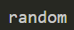
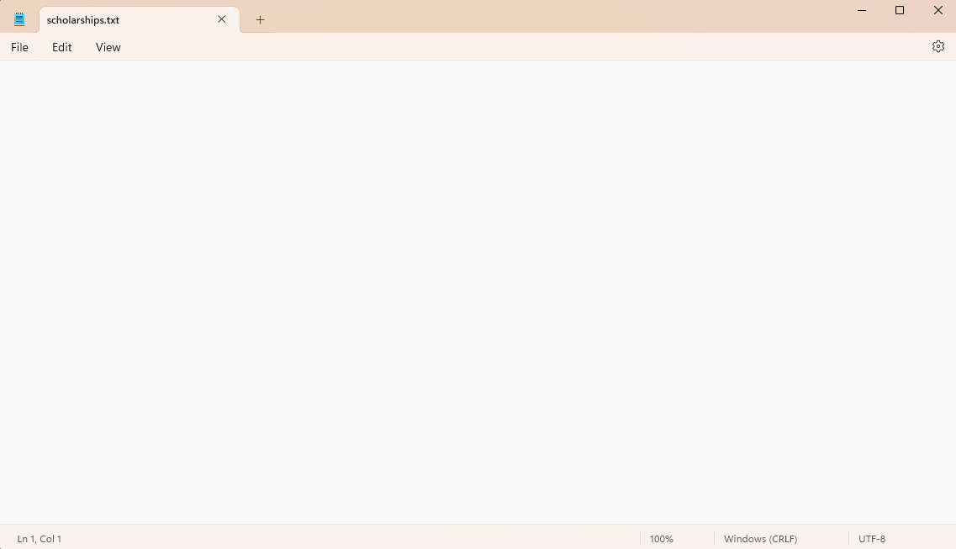
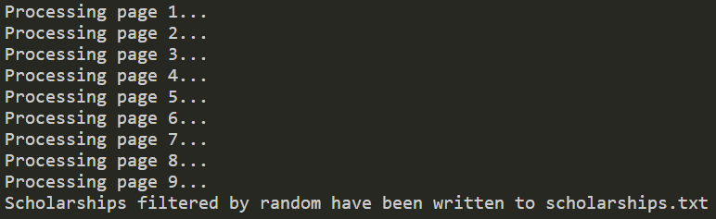
Test Case 3
Input
Processing
Output
Notes:
Tofik

Slide 10

Live Demo
Notes:
Tofik and Halil

Slide 11



Improvements and Scaling
Automation and Scheduling
Automate the scraping process to run at regular intervals, ensuring the most up-to-date scholarship information is always available
Implement notification systems to alert users when new scholarships matching their criteria are found.
User Interface
Expand the preferences a user can have in their search, aside from keywords found in the scholarship description
These new filters will include options for users to specify preferences such as scholarship amount.
Modular Web Scraping
Implement a more flexible scraping module that can adapt to different website structures without code modification.
Utilize a configuration-driven approach where website-specific details (like tags and classes) are stored in external files or databases.
Notes:
Tofik

Slide 12
THANK YOU!
Notes:
Tofik

Slide 13


